Slide 1
Please make sure there’s a “Module Transition” slide for every module
03 | Web API Configuration
Jeremy Likness | Principal Architect
Christopher Harrison | Content Developer

Slide 2
Module Overview
Please leave this area blank to allow for picture in picture recording
Media Formatters
Camel Case and Serializers
Routes and Actions
Attribute Routing
Custom Content Negotiation

Slide 3
Media Formatters
Please leave this area blank to allow for picture in picture recording
Media type = MIME type
Examples: text/html, application/xml, application/json
Accept (what it wants), Content-Type (what it gets)
Built in formatters: XML, JSON, BSON, form-encoded
Create custom with MediaTypeFormatter, BufferedMediaTypeFormatter

Slide 4
Custom Media Formatter: CSV Export
Please leave this area blank to allow for picture in picture recording
Notes:
03aCustomMediaFormatters

Slide 5
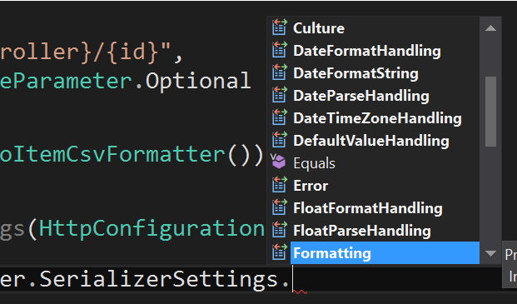
Camel Case and Serializers
Please leave this area blank to allow for picture in picture recording
MediaFormatter performs serialization
Several SerializerSettings

Slide 6
Proper JavaScript Case
Please leave this area blank to allow for picture in picture recording

Slide 7
Routes and Actions
Please leave this area blank to allow for picture in picture recording
…

Slide 8
Attribute Routing
Please leave this area blank to allow for picture in picture recording
…

Slide 9
Custom Content Negotiation
Please leave this area blank to allow for picture in picture recording
…

Slide 10
Case Study: GitHub API
Please leave this area blank to allow for picture in picture recording
Notes:
https://developer.github.com/v3/ -> start at https://api.github.com/users/jeremylikness and drill down

